Slide 1
Peer to Peer Energy Marketplace
Caroline Quinn, Patrick Osborne, Letitia Zainea, Anna Gorbatcheva, Tudor Malene

Slide 2
The background: why we chose to address this challenge
Many European utility providers (e.g., EDF, SSE) are not built to facilitate households to sell or buy energy locally
However, increasing numbers of producer-consumers or ‘prosumers’ are able to generate, use and store electricity locally ¹
Bypassing dominant energy providers, prosumers can trade energy locally by combining blockchain technology with smart meters in groups
To help solve this, we developed a Cordapp for local ‘prosumers’ to trade their electricity together
Source:
1:– by 2050, ~50% of European households could be involved in producing renewable energy https://www.cedelft.eu/publicatie/the_potential_of_energy_citizens_in_the_european_union/1845

Slide 3
(Em)powering the local community - introducing “Hackney Microgrid”
The challenge
Overview of set-up
Process flow
Demo
Why is this the perfect Cordapp?

Slide 4
Assumptions made in this Cordapp
Households all have smart meters, which are tamper-proof and are able to record and communicate energy usage
All smart meters are connected to Corda and can sign transactions
Energy is traded after it is consumed
Energy price: Grid to Prosumer -> 14p | Prosumer to Grid -> 4p | Prosumer to Prosumer -> 9p
Every household is able to upload ‘money’ represented by tokens, which are exchanged every 30 minutes
The neighbourhood can act as a unified “Single Load” - having a single contract with a Utility Provider

Slide 5
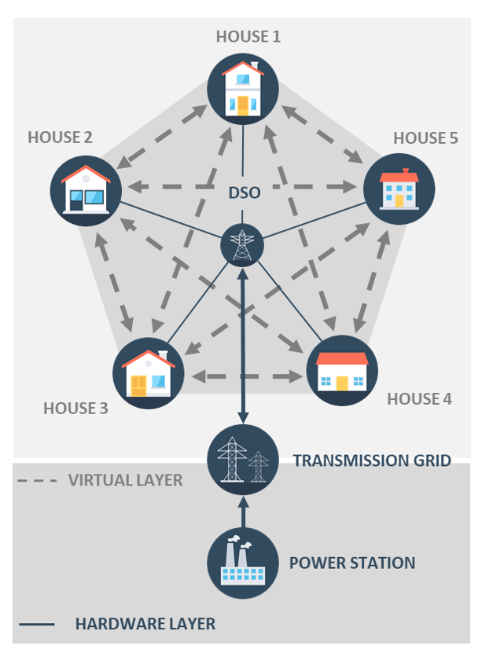
At a high level, the following steps are followed in the Cordapp every 30 minutes
Smart meters sign and publish their energy surplus / demand for the past 30 minutes to the ‘Corda-nator’ (one of the households, a role which rotates)
The Corda-nator validates and distributes the reading to all nodes
Based on everyone’s values, an advanced netting algorithm distributes costs and profits fairly
The group will draw on their contract with a utility provider to satisfy any demand not met
A financial transaction is created and signed by all parties
Money (represented by tokens) changes ownership based on Step 3

Slide 6
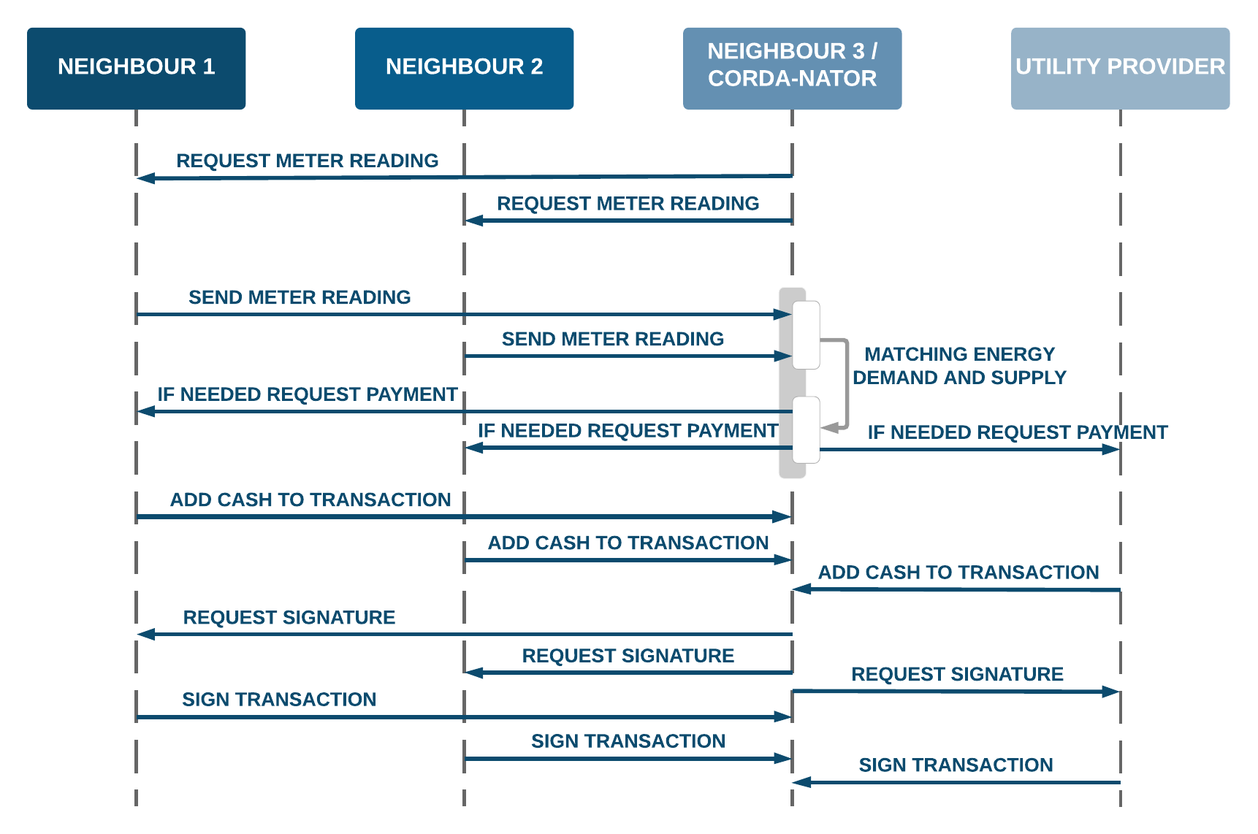
Detailed process map

Slide 7
Input States
Output States
+50kWh
Alice
✓
Energy
Alice
Netting process
+20kWh
John
✓
John
Energy
-40kWh
Jane
✓
Jane
-10kWh
Jack
✓
Jack
+4 GBP
Jane
Alice
+4 GBP
Cash
+1 GBP
John
+2 GBP
Cash
Jack
+1 GBP
Utility

Slide 8
Demo
We are running a simulation in which every neighbour generates or consumes random values every 30 minutes. We then run a netting algorithm which

Slide 9
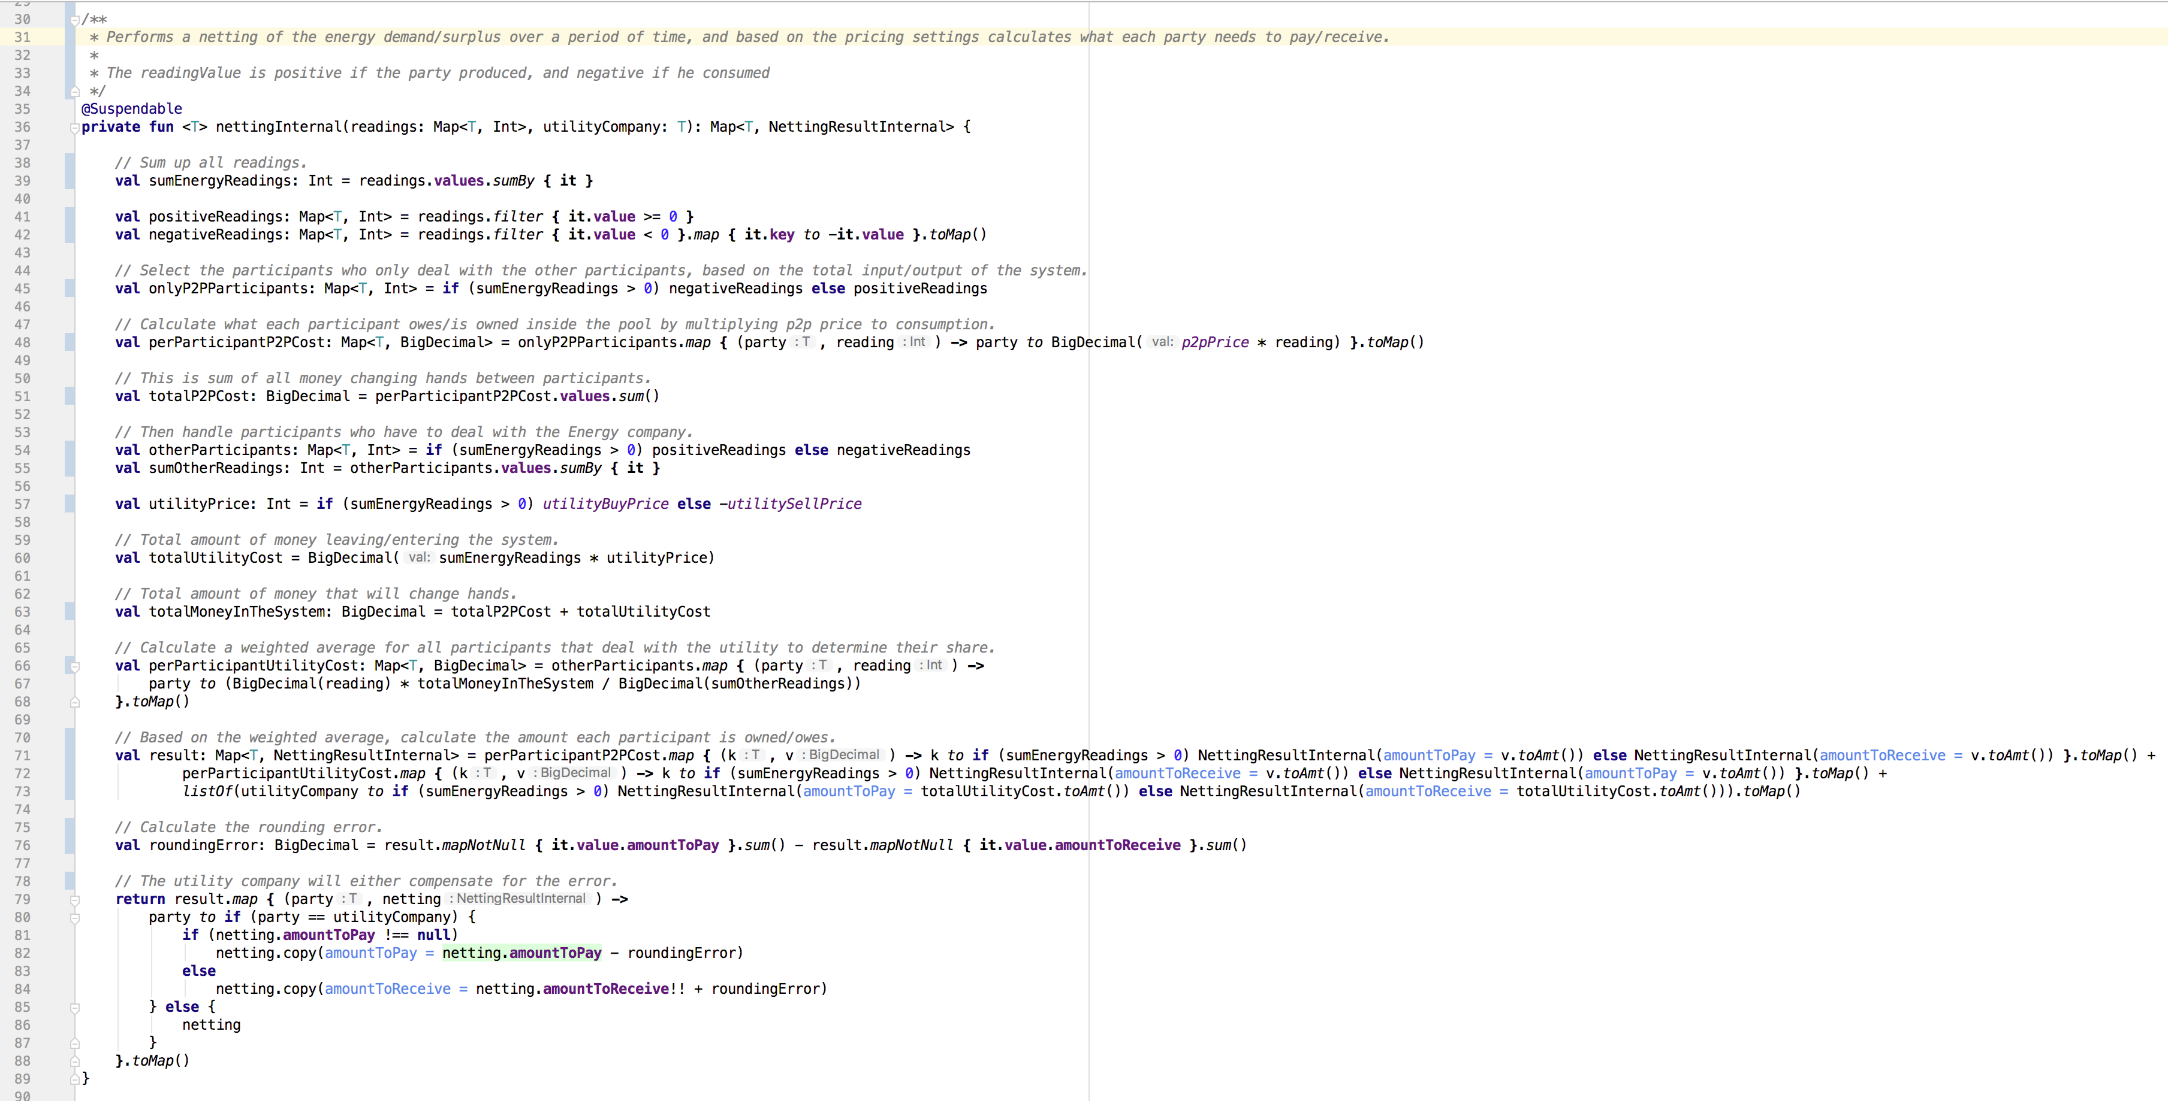

Slide 10
Why this is the perfect Cordapp…
1. Introducing a centralised third party is technically possible but commercially and politically undesirable. Therefore, this could not be done with a database operated by a centralised controller.
2. ‘Prosumers’ will be unlikely to trade in an efficient way using other technology able to match their own needs; they will either generate too much or too little on a consistent basis.
3. Participants do not fully trust each other but they want to transact with each other

Slide 11
Scaling in the future…
The next step could be to trial with a larger group, 20-30 households - to test the software and hardware, with bigger energy generation and storage capacity
However, for this really to take off: people will need to invest in their own infrastructure which may require government subsidies to grow substantially
In future, the CorDapp can be integrated with a battery and release energy only when there is high demand

